Slide 1
QA Passage Retrieval Using Dependency Relations
Zhang Zhichang
2005-11-21

Slide 2
Preface
The paper is from SIGIR 2005.
The author is CuiHang in National University of Singapore.
http://www.comp.nus.edu.sg/~cuihang/

Slide 3
Outline
Introduction
Related works
Fuzzy relation matching for passage retrieval
  Extracting and paring relations paths
  Measuring path matching score
  Model training
Evaluations
Conclusions

Slide 4
Introduction
Passage retrieval has long been studied in IR.
Passage retrieval has become a crucial component in QA systems.
Question
Question Analyzer
Query
Document Retrieval
Documents
Passage Retrieval
Passage
Answer Extractor
Answers
Notes:
Passage retrieval has long been studied in IR. You know that current SE just return many relevant documents according to users’ query, and users have to scan every document totally in results even if he just want to learn about a little message. it search for more precise and compact text segment, then users’ search time will be saved. The length of a passage can vary from one sentence to several sentence.
This is a simple flow chat of typical QA system. It is composed of four modules.

Slide 5
Introduction
The simplest passage retrieval technique can be based on lexical matching.
  Neglecting crucial relations between words
  Many irrelevant passages share the same question term with correct ones.
Notes:
If we divide a document to several passages, and use a method to retrieve the relevant answer passages in them. We can suppose there are not relations between words, and every word is independent with others, and we just match common words between question and candidate passages.
Although this technique is simple, it exists several problems.

Slide 6
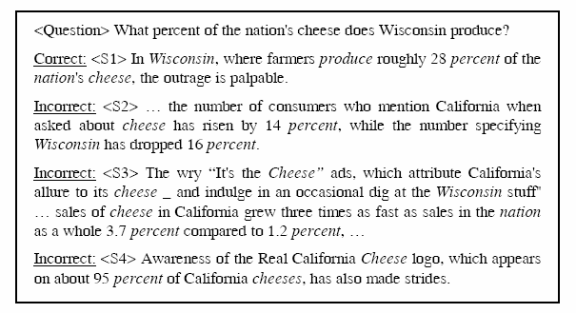
Introduction
A sample question and some candidate sentences

Slide 7
Introduction
A good idea is to match relations in candidate sentences with their corresponding relations in the question.
  Problem
    The same relationship is often phrased differently in the parse tree of the question and the answer.
    Strict matching of relations may fare poorly in recall

Slide 8
Introduction
A novel fuzzy relation matching method
  Examines grammatical dependency relations between question terms
  A statistical technique for measuring the degree of match of relevant relations
  Not to match dependency relations strictly.
  Employ Minipar
Notes:
To address this problem, the author proposed a novel fuzzy dependency relation matching method. This method also examine the grammatical
Dependency relations between question terms to improve current passage retrieval techniques for QA, but it is a statistical technique and not to match dependency relations strictly.
It use Minipar to get parse tree of question and candidate sentences. (to accomplish dependency parsing). Minipar is a fast dependency parser.

Slide 9
Related works
Almost all QA systems fielded at TREC employ some passage retrieval technique.
  Reduce the size of the relevant document set.
The simplest passage retrieval method counts the number of matched question terms in a passage.
  Employed by MITRE.
Some methods are density-based as they take into account the distance between question terms in the candidate passages.
  Employed by SiteQ and IBM
Some language modeling approaches capture simple dependency relations by using bigrams.
  Only capture dependency relations between adjacent words.
Notes:
Research in QA has been catalyzed by TREC series since TREC-8 in 1999.
It aims to reduce the size of the relevant document set to a manageable number of passages.
Density-based methods: not just count the number of matched question terms in a passage , it concerns the distance between questions terms in the candidate passages.
The goal of passage retrieval is to identify passages similar to the question in semantic content.
All existing passage retrieval algorithm rely only on lexical level matching to rank passages. The underlying assumption is that each question term is considered an independent token. However, this is too simple and does not hold in many cases, because dependency relations exist between words.
So some work has been done to address this problem. For instance, some language modeling approaches capture simple dependency relations by using bigrams, but these models only capture dependency relations between adjacent words (word is next to other).

Slide 10
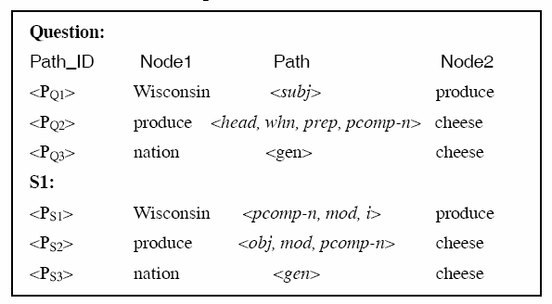
Fuzzy relation matching for passage retrieval Extracting and paring relation paths
Generating dependency trees for question or candidate sentences using Minipar.
  In a dependency tree, each node represents a word or a chunked phrase
  Links between nodes represent the dependency relations
Notes:
This figure is some relations in dependency trees for the sample question and sentence s1.
Some nodes are omitted due to lack of space.

Slide 11
Fuzzy relation matching for passage retrieval Extracting and paring relation paths
Ignoring the directions of relations.
Defining a relationship path between nodes n₁ and n₂ as the series of edges that travers from n₁ to n_{2 .}
  Considering a path as a vector P <Rel_{i}>, where Rel_{i} denotes single relations.
  Excluding exceptionally long paths as Minipar only resolves nearby dependencies reliably.
  The number of relation paths in a sentence with n non-trivial terms？
Notes:
Although dependency relations are directed links, we ignore the directions of relations.
Because the roles the terms as governor and modifier often change in question and answers.
Relation labels.
The concept of relations path is used in this method.

Slide 12
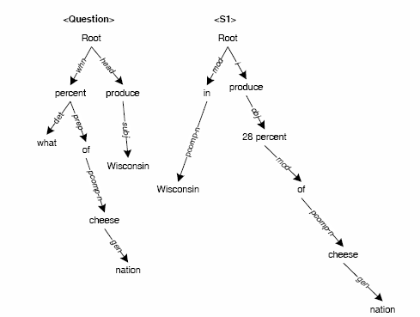
Fuzzy relation matching for passage retrieval Extracting and paring relation paths

Slide 13
Fuzzy relation matching for passage retrieval Extracting and paring relation paths
To determine the relevance of a sentence given another sentence (or question) in terms of dependency relations
  Two paths from two sentences are determined as paired corresponding paths if their nodes at both ends are matched.
    <P_{Q1}> Wisconsin <subj> produce
    <P_{S1}> Wisconsin <pcomp-n,mod,i> produc
  To examine the total similarity of all the corresponding paths embedded in these two sentences.
Notes:
After the dependency relation paths are extracted, we should to determine the relevance of a sentence given another sentence
(or question) in terms of dependency relations.
A very important concept should be defined.
To determine the relevance of a sentence, we need to examine the total similarity of all the corresponding paths.

Slide 14
Fuzzy relation matching for passage retrieval
Measuring path matching score
To measure the matching score of the paths extracted from the sentence according to those from the question.
  Example
Notes:
After extracting and pairing the relation paths from a question and a candidate sentence, we need to …

Slide 15
Fuzzy relation matching for passage retrieval
Measuring path matching score
To measure the matching score of the paths extracted from the sentence according to those from the question.
  Example
    Score_{S1}=path_score_{<pcomp-n,mod,i>}
  +path_score_{<obj,mod,pcomp-n>}
  +path_score_{<gen>} + ……
  To derive the matching score between paths by extending IBM statistical translation model 1.
  To treat the matching score of a relation path from a candidate sentence as the probability of translating to its corresponding path in question.
Notes:
The score of a candidate sentence or similarity of a candidate sentence can be regarded as the total paired corresponding relation paths score in this candidate sentence.

Slide 16



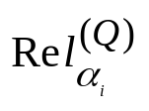

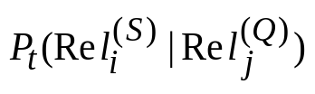
Fuzzy relation matching for passage retrieval
Measuring path matching score
Example
  One path P_{s} in S:
  Corresponding path P_{Q} in Q:
The translation probability Prob(P_{S}|P_{Q}) is:
  is the corresponding relation of (alignments of relations)
  denotes the relation translation probability given by a translation model learned during training.
Notes:
The probability of path Ps is the multiplication from rel1’s translation probability to reln’s translation probablity.
the model assume that every relation can be translated to another, so there are n sums,
and ai is the translation alignment of relation in question.
M to the nth

Slide 17
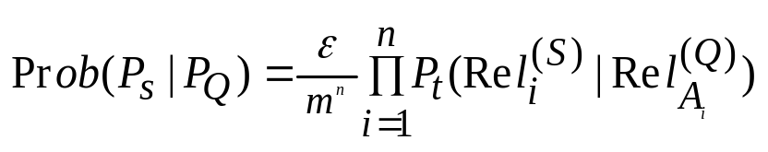
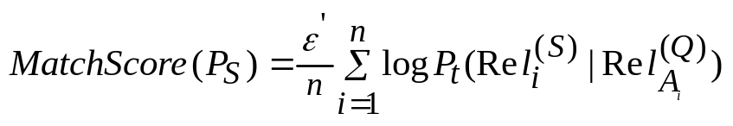

Fuzzy relation matching for passage retrieval
Measuring path matching score
for each relation in the path from the sentence
  To calculate the alignment by finding the most probable mapped relation in the path from the question.
  A_{i} denotes the most alignment.
  To take the log-likelihood of equation and remove all constants:
Total matching score of a sentence:
Notes:
For each relation in the path from the sentence, we consider only the most probable alignment.
Most often, the most probable alignment gives much higher probability than any other alignments.
The path translation probability can be simplified.

Slide 18
Fuzzy relation matching for passage retrieval
Model Training
To acquire relation mapping model by two statistical methods from training question-answer pairs.
  Mutual information (MI)
  Expectation maximization (EM)
The relation mapping between training answer sentences and questions can be used as a model for unseen questions and potential answers.
Notes:
In the above section, we described how to obtain a relation matching score between a sentence and the question,
and the translation probability of relations should be calculated using relation mapping model.

Slide 19

Fuzzy relation matching for passage retrieval
Model Training
To calculate relation mapping scores:
  Employing a variation of mutual information:
  δ(Rel_{j}^{(Q)},Rel_{i}^{(S)}) is an indicator function which return 1 when Rel_{j}^{(Q)} and Rel_{i}^{(S)} appear together in a training path pair, and 0 otherwise;
  γ is the inverse proportion of the sum of the lengths of the two paths.
Notes:
We first employ a variation of mutual information to calculate relation mapping scores.
Different from standard mutual information, we account for path length in our calculations.
Mod rel(Q) or rel(s) stands for the number of paths extracted from all questions in which relation rel occures.

Slide 20
Fuzzy relation matching for passage retrieval
Model Training
To calculate relation mapping scores:
  Employing GIZA to implement IBM translation model 1 training over the paired training paths.
    Each relation is considered a word.
    Each corresponding path pair is treated as a translation sentence pair.
    The resulting word translation probability table is used to define relation mapping score
  GIZA performs an iterative training process using EM to learn pairwise translation probablities.
  Initializing the training process by setting translation probability between identical relations to 1 and a small uniform value for all other cases.
Notes:
In the second configuration, the paper employ GIZA.

Slide 21
Fuzzy relation matching for passage retrieval
Evaluations
Experiment setup
  Corpus to search for answers: AQUAINT
  Use the factoid questions from the TREC-12 QA task as test data.
  Generate standard answer passages based on the official judgment list provided by TREC.
  Use TREC-8 and 9 QA tasks as training data
    3,026 unique corresponding path pairs for model construction.
  Assess returned passages:
    Using TREC-supplied exact answer patthers
    Calculating cosine similarity with any standard answer passage ( >= 0.75)
Notes:
The author generate a list of passages for each question as standard answer passages,
and these passages are judged to be correct and supported by the corpus.

Slide 22
Fuzzy relation matching for passage retrieval
Evaluations
Experiment setup
  Take one sentence as a passage
  Conduct different passage retrieval algorithms on the relevant document set to return the top 20 ranked passages.
    The relevant document set of each question is provided by TREC.
Notes:
In evaluations for relation matching techniques, the paper take one sentence as a passages.

Slide 23
Fuzzy relation matching for passage retrieval
Evaluations
Experiment setup
  Use four systems for comparison:
    MITRE(baseline): simply matches stemmed words between question and answer.
    Strict matching of relations: count the number of exact path matches as score.
    SiteQ: one of the top performing density-based systems.
    NUS: another top-performing factoid question answering system.

Slide 24
Performance evaluation
Performance metrics:
  Mean reciprocal rank (MRR).
  Percentage of questions that have no correct answers.
  Precision at the top one passage.

Slide 25
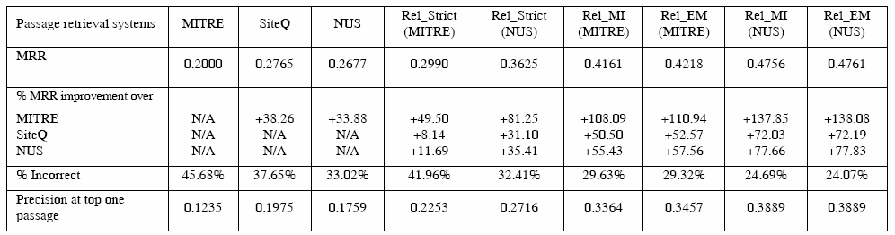
Performance evaluation
Overall performance comparison

Slide 26
Performance evaluation
Draw the following observations:
  Applying relation matching over lexical matching methods boosts system performance dramatically.
  Fuzzy relation matching outperforms strict matching significantly.
  Using MI and iterative EM to train relation mapping scores does not make any obvious difference.

Slide 27
Conclusion
Presented a novel fuzzy relation matching techniques for factoid QA passage retrieval.
  Evaluation results show that this technique produces significant improvements in retrieval performance in current system:a vast 50~138% improvement in MRR, and over 95% in precision at top one passage.
Fuzzy matching of dependency relations is calculated based on the degree of match between relation paths in candidate sentences and the question.
Presented two methods based on mutual information and iterative EM to learn a model of relationship matching from training data.

Slide 28
Thanks!

